Slide 1

Williams
WARNING
FOR SAFETY AND PROPER GAME OPERATION, GAME MUST BE PLUGGED INTO A PROPERLY GROUNDED OUTLET. 117 VAC 60HZ.
“THIS EQUIPMENT HAS NOT BEEN TESTED TO SHOW COMPLIANCE WITH NEW FCC RULES (47 CFG PART 15) DESIGNED TO LIMIT INTERFERENCE TO RADIO AND TV RECEPTION. OPERATION OF THIS EQUIPMENT IN A RESIDENTIAL AREA IS LIKELY TO CAU SE UNACCEPT-ABLE INTERFERENCE TO RADIO COMMUNICATION REQUIRING THE OPERATOR TO TAKE WHATEVER STEPS ARE NECESSARY TO CORRECT THE INTER-FERENCE.” STD-A707
®
ELECTRONICS GAMES, INC.
3401 N. CALIFORNIA AVE., CHICAGO, IL 60618
AMUSEMENT MACHINE
SUITABLE FOR INDOOR USE ONLY
TESTED BY # 23
MODEL
TESTED BY # 23
ROBOTRON 2084
S/N
578327
TESTED BY # 23
VOLTS
115V 60H
AMPS
8.0
16-8567-888-1
WARRANTY VOID IF REMOVED
POWER
ON
STD. 739

Slide 2
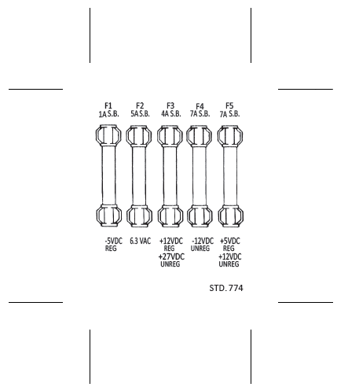
DEPRESS ADVANCE PUSHBUTTON TO DISPLAY BOOKEEPING TOTALS ON SCREEN.
RECORD BOOKEEPING TOTALS.
DEPRESS ADVANCE PUSHBUTTON TWO TIMES TO RETURN TO GAME OVER.
ACCESS TO ADVANCE PUSHBUTTON
(FOR BOOKEEPING TOTALS) THRU
HOLE IN TOP OF
COIN BOX HOUSING.
STD. 739
INSERT LINE CORD IN SLOT
STD. 739
C-8783
16-8850-26

Slide 3



2084 ROM 3-A
© 1982 WILLIAMS
ELECTRONICS, INC.
2084 ROM 2-A
© 1982 WILLIAMS
ELECTRONICS, INC.
2084 ROM 1-A
© 1982 WILLIAMS
ELECTRONICS, INC.
2084 ROM 3-A
© 1982 WILLIAMS
ELECTRONICS, INC.
2084 ROM 2-A
© 1982 WILLIAMS
ELECTRONICS, INC.
2084 ROM 1-A
© 1982 WILLIAMS
ELECTRONICS, INC.
3005-7
3005-7
3005-7
3005-7
3005-7
3005-7
2084 ROM 6-A
© 1982 WILLIAMS
ELECTRONICS, INC.
2084 ROM 5-A
© 1982 WILLIAMS
ELECTRONICS, INC.
2084 ROM 4-A
© 1982 WILLIAMS
ELECTRONICS, INC.
2084 ROM 6-A
© 1982 WILLIAMS
ELECTRONICS, INC.
2084 ROM 5-A
© 1982 WILLIAMS
ELECTRONICS, INC.
2084 ROM 4-A
© 1982 WILLIAMS
ELECTRONICS, INC.
3005-7
3005-7
3005-7
3005-7
3005-7
3005-7
2084 ROM 9-A
© 1982 WILLIAMS
ELECTRONICS, INC.
2084 ROM 8-A
© 1982 WILLIAMS
ELECTRONICS, INC.
2084 ROM 7-A
© 1982 WILLIAMS
ELECTRONICS, INC.
2084 ROM 9-A
© 1982 WILLIAMS
ELECTRONICS, INC.
2084 ROM 8-A
© 1982 WILLIAMS
ELECTRONICS, INC.
2084 ROM 7-A
© 1982 WILLIAMS
ELECTRONICS, INC.
3005-7
3005-7
3005-7
3005-7
3005-7
3005-7
2084 ROM 10-A
© 1982 WILLIAMS
ELECTRONICS, INC.
2084 ROM 11-A
© 1982 WILLIAMS
ELECTRONICS, INC.
2084 ROM 12-A
© 1982 WILLIAMS
ELECTRONICS, INC.
2084 ROM 10-A
© 1982 WILLIAMS
ELECTRONICS, INC.
2084 ROM 11-A
© 1982 WILLIAMS
ELECTRONICS, INC.
2084 ROM 12-A
© 1982 WILLIAMS
ELECTRONICS, INC.
3005-7
3005-7
3005-7
3005-7
3005-7
3005-7
WARRANTY VOID IF REMOVED
578327
Williams
SPECIAL CHIP 1
© 1982 WILLIAMS
ELECTRONICS, INC.
STD. 766
®
ELECTRONICS, INC. STD. 656
THIS BOARD USES TYPE
A ROMS ONLY.
STD. 728
578327
WARRANTY VOID IF REMOVED
578327
SPECIAL CHIP 1
© 1982 WILLIAMS
ELECTRONICS, INC.
STD. 766
Williams
Williams
®
®
®
ELECTRONICS, INC.
ELECTRONICS, INC. STD. 656
STD. 739

